Slide 1
Used Car Evaluation System
● Practical Data science project by: ●
Mustafa Sajjad, msajjad@my.okcu.edu
Rishitha, rkatta@my.okcu.edu
Nithin reddy gantla, ngantla@my.okcu.edu

Slide 2
01
Business Understanding
02
Data Understanding
CONTENTS
03
Data Preparation
04
Modeling
05
Evaluation
06
Conclusion

Slide 3
Business Understanding
The objective of this project is to predict car prices based on various features. The code aims to develop a machine learning model using linear regression to make these predictions.

Slide 4
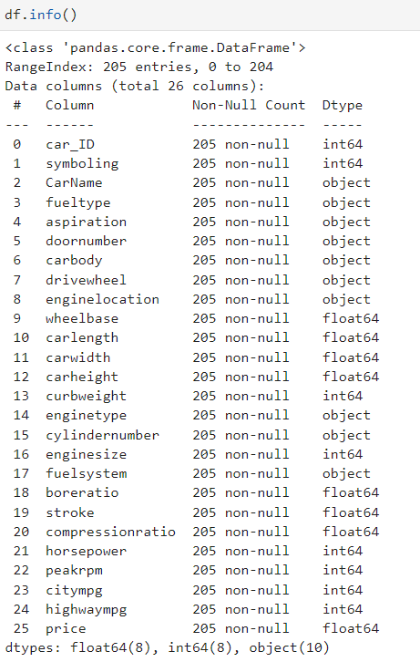
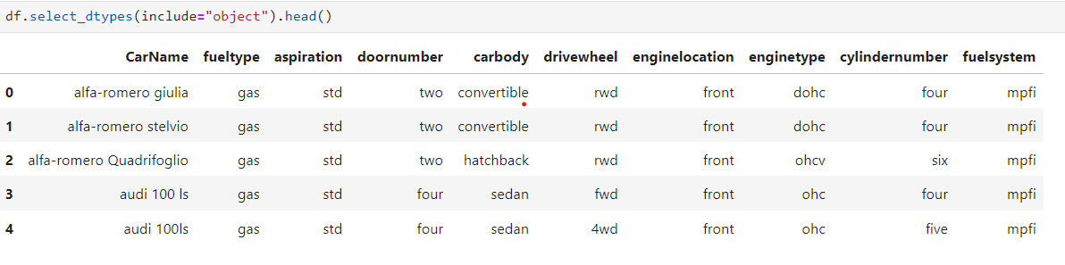
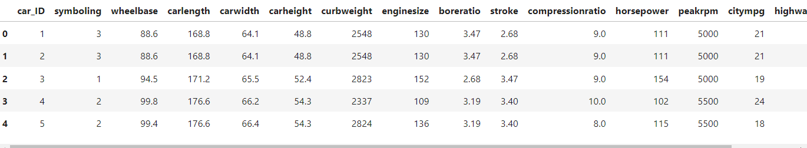
Data Understanding
This stage involves exploring and understanding the dataset.
Enter title
This Template Is Designed By Zuo An,It Will Help You Make You Report Easy And Fast.

Slide 5
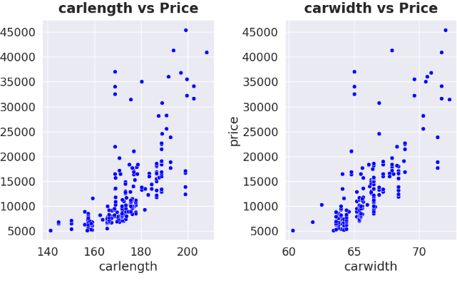
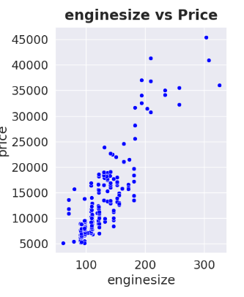

Slide 6
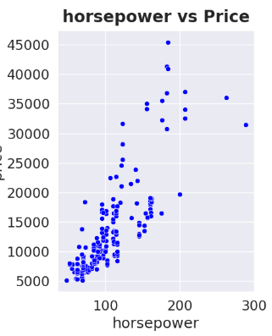
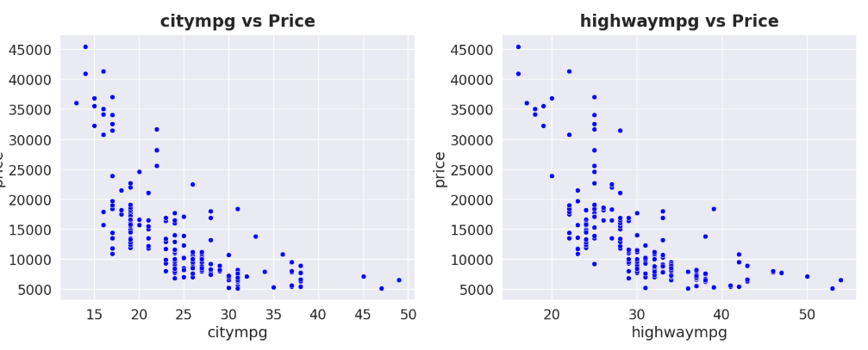

Slide 7
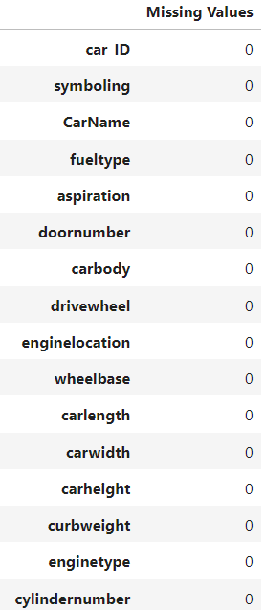
Data Preparation
Data preparation is a crucial step in the data science workflow that involves cleaning, transforming, and organizing raw data into a format suitable for analysis or model training. This process ensures that the data is accurate, complete, and relevant for the tasks at hand.
Handle Missing Values:
Check for missing values using df.isnull().sum().
Decide on a strategy to handle missing values, such as removing rows/columns or imputing values.

Slide 8

Handle Duplicate Values:
Check for duplicate rows using df.duplicated().sum().
Decide whether to keep or remove duplicate rows.
Feature Engineering:
Extract relevant information from existing features or create new features. we extract the company name from the "CarName" feature and perform some replacements.
Handling Categorical Variables:
Convert categorical variables into a numerical format suitable for machine learning models. we use one-hot encoding (pd.get_dummies) to convert categorical variables .
Feature Scaling:
Scale numerical features to bring them to a similar scale, preventing certain features from dominating others. we use StandardScaler to standardize numerical features.

Slide 9
Modeling
Data modeling is a critical phase in the data science and machine learning pipeline that involves selecting, training, and evaluating a predictive model using the prepared dataset. Below are the key steps and considerations involved in data modeling:
Selecting a Model:
Choose a suitable model based on the nature of the problem (classification, regression, etc.) and the characteristics of the data. Common models include linear regression, decision trees, random forests, support vector machines, and neural networks.
Feature Selection:
Identify the most relevant features for the model. Eliminate features that may not contribute significantly to the model's predictive power.
Splitting the Data:
Divide the dataset into training and testing sets. The training set is used to train the model, and the testing set is used to evaluate its performance on unseen data. This is done using train_test_split .
Model Training:
Fit the chosen model to the training data. This involves adjusting the model's parameters to minimize the difference between its predictions and the actual outcomes. we use the fit method on a Linear Regression model.

Slide 10
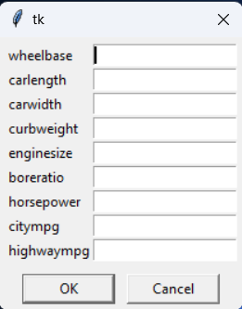
Evaluation
The R-squared score (r2_score) is calculated to evaluate the model's performance on both the training and testing sets. R-squared measures the proportion of the response variable's variance that is captured by the model.
The R-squared score ranges from 0 to 100%, where a higher value indicates a better fit. It represents the proportion of the variance in the dependent variable that is predictable from the independent variables. An R-squared of 100% means that the model explains all the variability of the target variable.

Slide 11
Conclusions
This project focused on analyzing and predicting car prices using a dataset. Key steps included data exploration, cleaning, and feature engineering, leading to the creation of a robust dataset. The Linear Regression model was trained and evaluated, achieving satisfactory results with R-squared scores on both training and testing sets. The project showcased the importance of feature engineering, data preprocessing, and model evaluation in building a successful predictive model for car prices. Future work may involve exploring advanced models and incorporating additional visualizations for a more comprehensive analysis.

Slide 12
References [1] "https://www.kaggle.com/code/dronax/car-prices-dataset"
[2]"Linear Regression Analysis" by George A. F. Seber and Alan J. Lee. This book provides a detailed and mathematical treatment of linear regression analysis.

